Slide 1


Slide 2
DATA
SONG
Hacking Arts 2015
Using heartbeats and movement to create music

Slide 3

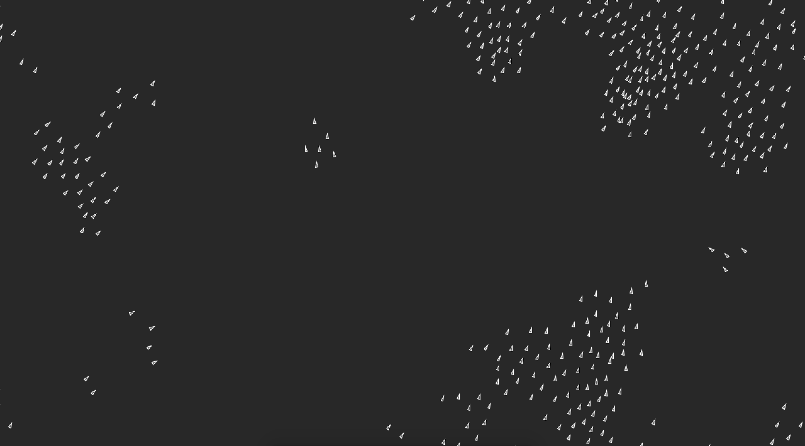


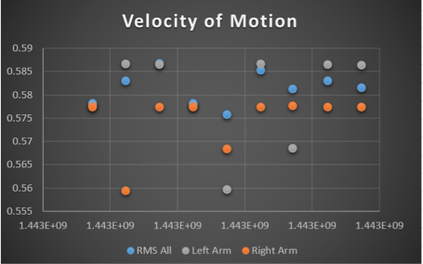

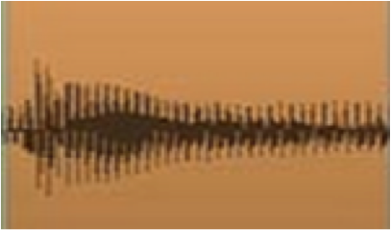
From Data to Art
VISUALIZATION:
DATA:
-Lightwave (heart rate, skin temperature, arm/leg motion
-Google Maps (location)
MUSIC:

Slide 4

Input Output Mapping
Drum tempo
Heart rate
Melody pitch
Hand motion
Melody tempo
Bass fill ON/OFF
Leg motion
Bass fill tempo
Location
Visualization centroid
Visualization birth rate

Slide 5


